Slide 1
Machine Learning II
Boosting Methods
Team 5
Chloe Ge
Aaron Fernandez
Nick Hoffman
Brian McGowan

Slide 2
Table of Contents
Introduction to Boosting
Difference between Boosting and Bagging / Random Forests
Discuss Boosting Algorithm
Video from Johns Hopkins University
Lab 8.3.4 and Ada Boost in Markdown - Boosting
Chapter 8 - Exercise 10

Slide 3
Introduction
The term Boosting refers to a family of algorithms which attempts to convert weak predictors to strong predictors.
It is one of the most widely used algorithms by Data Scientists, and extremely popular in ML and AI communities
Frequently used in Kaggle competitions
What is Boosting?

Slide 4
What is boosting?
Trees are grown sequentially - each tree is grown using information from previously grown trees.
Each tree is fit on a modified version of the original data set.
Fit a tree using the current residuals as response
Then add new decision tree into fitted function in order to update the residuals
Construction of each tree depends strongly on the trees that have already been grown

Slide 5
What is boosting?
Learners are weighted relative to their accuracy
Allows future weak learners to focus more in the examples that previous weak learners misclassified
By building multiple models from dataset with another learning algorithm that isn’t necessarily a good learner, we then can boost the weight for the models that are hard to model accurately
Notes:
Learners are weighted relative to their accuracy
Misclassified examples gain weight
Classified examples are weighted less
This allows for future weak learners to focus more in the examples that previous weak learners misclassified
Original boosting algorithms weren’t adaptive and could not take full advantage of the weak learners
By building multiple models from dataset with another learning algorithm that isn’t necessarily a good learner, we then can boost the weight for the models that are hard to model accurately
Many weak learners lead to a strong aggregate model

Slide 6
History of Boosting
Gradient Descent
AdaBoost formulated as Gradient Descent with a loss function
Boosting Recognized
Freund and Schapire win prestigious Gödel Prize for AdaBoost
1996
2000
2017
AdaBoost Invented
First successful boosting algorithm by Yaov Freund and Robert Schapire
Gradient Boosting
AdaBoost generalized to Gradient Boosting to handle variety of loss functions
Enlightenment
First W&M MSBA class is enlightened by Boosting Algorithms
1998
2003

Slide 7
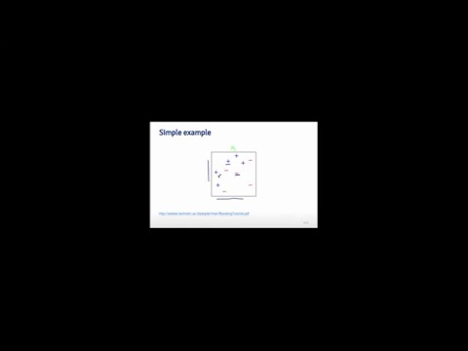

Slide 8
Boosting Algorithm
Weak Learning Algorithms
Weak-Learning Algorithm: Only slightly better than random guessing (i.e. in classification, model decides wrong <50% of time)
Many weak learners lead to a strong aggregate model
Method is known as Forward Stagewise Additive Modeling
Baysian-esque learning algorithm

Slide 9
Boosting - Difference between Boosting, Bagging and Random Forests
Ensemble Method: Uses weak classifiers to create one strong, final classifier
Meta-modeling: Uses a multitude of models to deliver a single, improved final model
Unlike fitting a single large decision tree to the data, which amounts to fitting the data hard and potentially overfitting, the boosting approach instead learns slowly. That is, we fit a tree using the current residuals of each tree iteratively, rather than the outcome Y , as the response.
Notes:
http://quantdare.com/2016/04/what-is-the-difference-between-bagging-and-boosting/

Slide 10
Random Forest/Bagging V.S. Boosting
Random Forest/Bagging
Fits many trees against different random samples of the data and average together
Trees are independent
Train set < sample
Boosting
Fits consecutive trees where each improves for the net error of the prior trees
Each consecutive tree learns and refines itself based on earlier fits and errors
Use all sample
Notes:
Random Forest:
Randomly samples in rows and columns
Fit many different trees entirely, but on different samples of data. Grow a full tree, get result, then shuffle data around, grow a new tree.
At the end, combine results of each trees which helps in predictive accuracy.
Result is average value over tree ensemble
Boosting:
Dependent trees
Fit a tree using the current residuals as response
Then add new decision tree into fitted function in order to update the residuals
Construction of each tree depends strongly on the trees that have already been grown
Random Forests
Strengths
Easy to use (Few parameters)
Competitive accuracy on most data sets
Weaknesses
Randomness in selection
Boosting
Strengths
Highest predictive power
Learns from previous models’ errors (forward stepwise adaptive model)
Weakness
Can be overfit
Sensitive to noise and outliers
Fails to perform with insufficient data

Slide 11
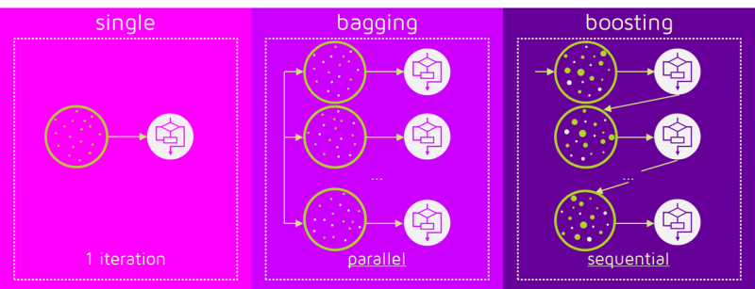

Slide 12
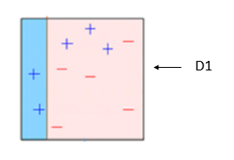
Decision Trees and the “Stump”
A decision stump is a machine learning model consisting of a one-level decision tree. That is, it is a decision tree with one internal node (the root) which is immediately connected to the terminal nodes (its leaves). A decision stump makes a prediction based on the value of just a single input feature.

Slide 13
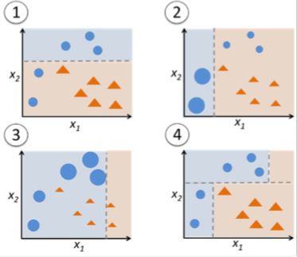
Boosting Algorithm
Types of Weak Learners
Stumps: Single axis parallel partition of space (Example on the right)
Decision Trees: Hierarchical partition of space
Parallel Splits: Representationally Restrictive, but easy to interpret and construct
Oblique Splits: Richer, but complex interpretation and construction

Slide 14
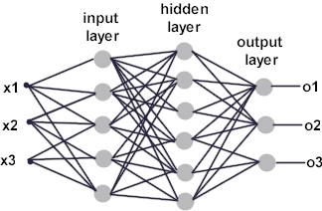
Boosting Algorithm
Types of Weak Learners
Multi-layer Perceptrons: General nonlinear function approximators
Radial Basis Functions: Non-linear expansions based on kernels
Multi-layer Perceptron

Slide 15
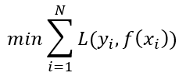
Boosting Algorithm
Methodology
Optimization Problem: Minimize Loss Function L(у, ŷ)
Boosts error in previous models to classify “problematic” observations

Slide 16
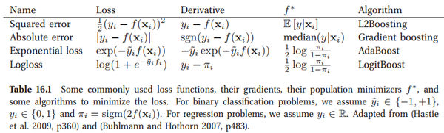
Boosting Algorithm
Types of Boosting

Slide 17
Boosting Algorithm
Tuning Parameters
B = Number of Trees. Use cross-validation to choose optimal B
Overfitting occurs if B is too large
λ = Shrinkage Parameter. Controls rate at which boosting learns
0 < λ << 1
Typical values are 0.01 or 0.001
d = Number of splits in each tree, or interaction depth
Controls complexity of boosted ensemble
d=1 is defined as a stump

Slide 18
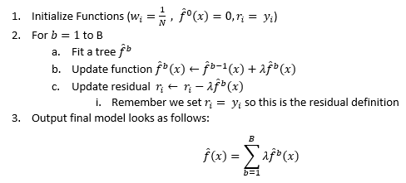
Boosting Algorithm From Book
Notes:
It is described as such:
* **gbm( formula, distribution = 'gaussian' or 'bernoulli', data = list(), n.trees = 100 trees, interaction.depth = 2 depth of the trees, shrinkage = 0.05 where 0.1 to 0.001 is ideal, )**

Slide 19
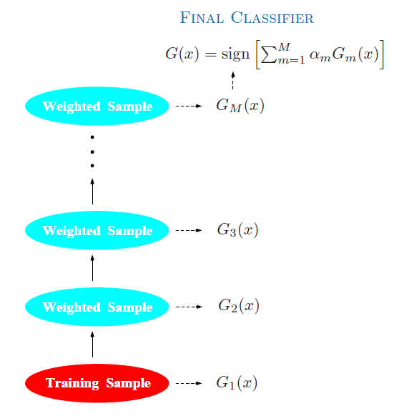
Adaptive Boosting
Original Boosting Algorithm
Usually uses stumps
Typically used for classification problems
Goal is to minimize errors by highlighting misclassified data points

Slide 20
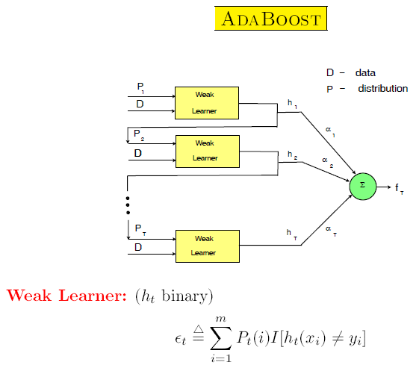

Slide 21
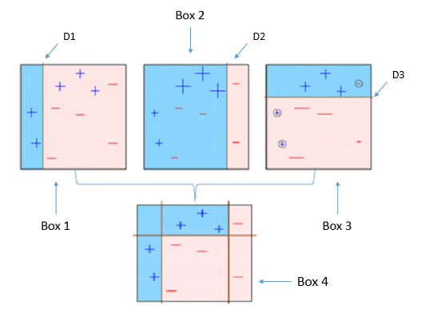
Boosting Algorithm
AdaBoost Additional General Parameters
Ε(...) = Error Function
ε = Weighted sum error for particular point (b decision tree)
Typically a fraction: misclassified observations / total observations
α = Function weight
Used to weigh individual function in final aggregation
Also used to define weights for misclassified observations

Slide 22
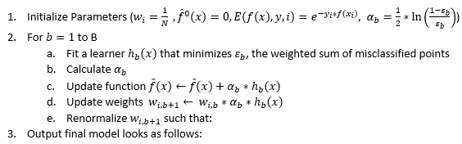



General AdaBoost Algorithm

Slide 23
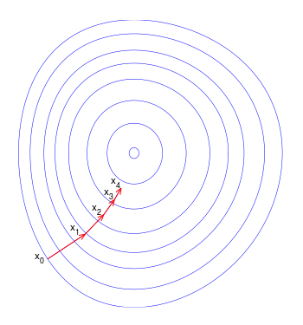
Gradient Descent
Used to generalize Adaptive Boosting
Optimization Problem
Minimizes the Loss Function of your Boosted Model
Helps avoid over-classification of outliers
Notes:
Image From: https://upload.wikimedia.org/wikipedia/commons/thumb/f/ff/Gradient_descent.svg/350px-Gradient_descent.svg.png

Slide 24
Real World Examples
Automated Text Categorization (http://dl.acm.org/citation.cfm?id=505283)
Face Detection
Gradient boosting has gained some popularity in the field of learning to rank. Commercial search engines Yahoo and Yandex use variants of gradient boosting in their machine-learned ranking engines.

Slide 25
Resources
Coursera ML Boosting File Dump: https://github.com/DataScienceSpecialization/courses/blob/master/08_PracticalMachineLearning/022boosting/index.Rmd
Boosting Slides: http://webee.technion.ac.il/people/rmeir/BoostingTutorial.pdf
More Boosting Slides: http://www.ccs.neu.edu/home/vip/teach/MLcourse/4_boosting/slides/gradient_boosting.pdf
Intro to Boosting: https://www.analyticsvidhya.com/blog/2015/11/quick-introduction-boosting-algorithms-machine-learning/
Relationship between Boosting, Bagging, and Random Forests: https://github.com/rasbt/python-machine-learning-book/blob/master/faq/bagging-boosting-rf.md

